Slide 1



Youtube Dataset
Foundations of Data Science
Project Presentation
Amirreza Akbari
Reza Baghestani
Hana Jamali

Slide 2





Phase #1
Phase #2
Phase #3
Dataset
Scrape
EDA
Youtube Channels
Purpose
Target Variable
Scrapy Framework
Social Blade
Top 100 channels in 24 countries
Preprocessing
Analyses
Plots
Relationships

Slide 3


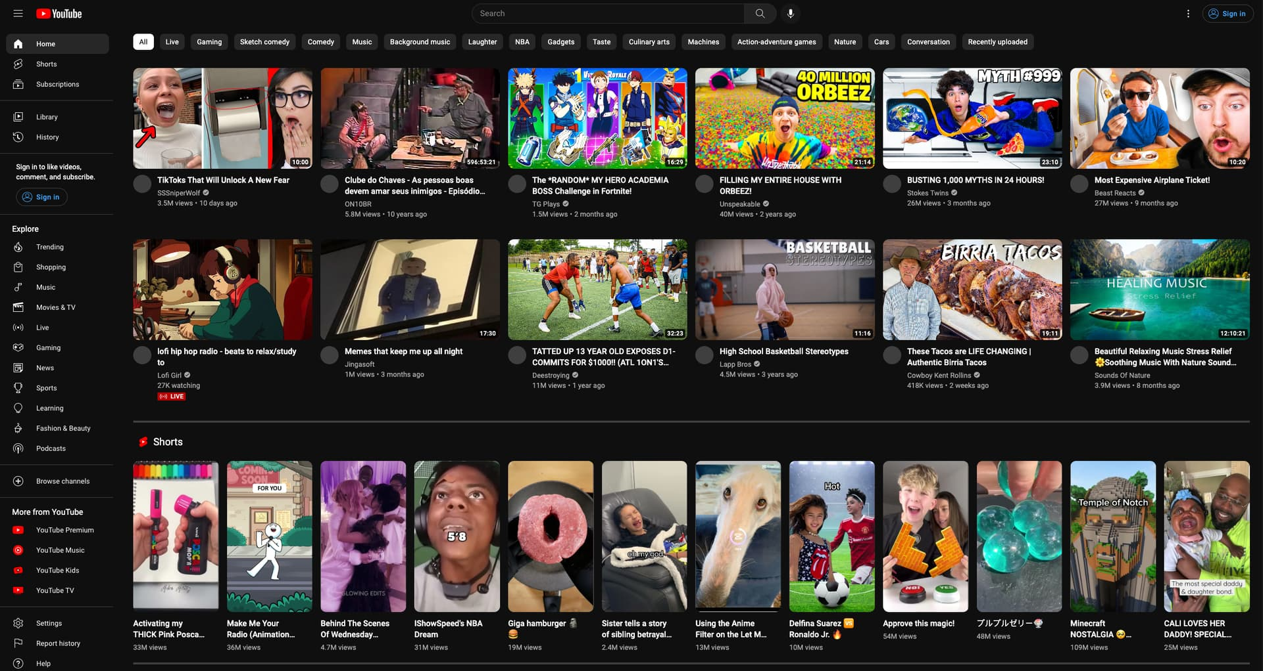
#1: Dataset
Brainstorm

Slide 4
#1: Dataset
Brainstorm
Money

Slide 5
#1: Dataset
Brainstorm
Money
Youtube

Slide 6
Phase #1
Phase #2
Phase #3
Dataset
Scrape
EDA
Youtube Channels
Purpose
Target Variable
Scrapy Framework
Social Blade
Top 100 channels in 24 countries
Preprocessing
Analyses
Plots
Relationships

Slide 7
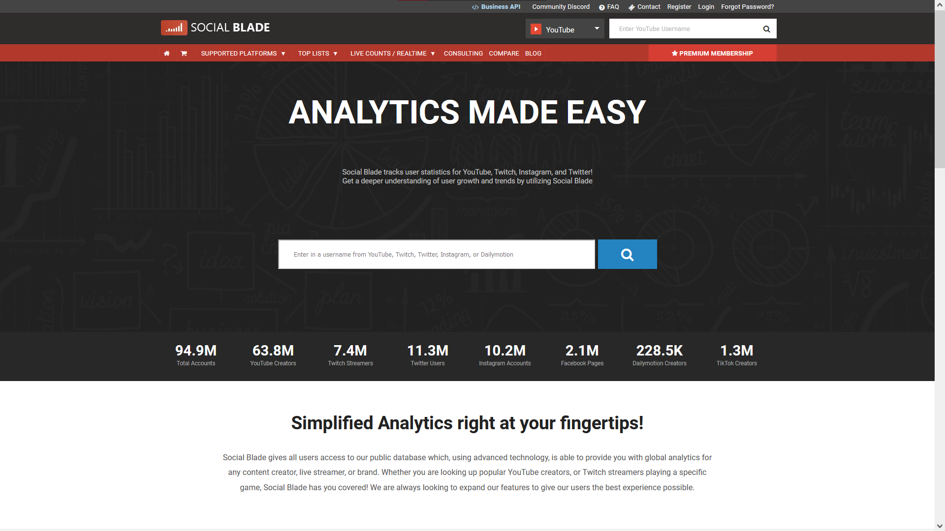
#2: Scrape
Social Blade

Slide 8
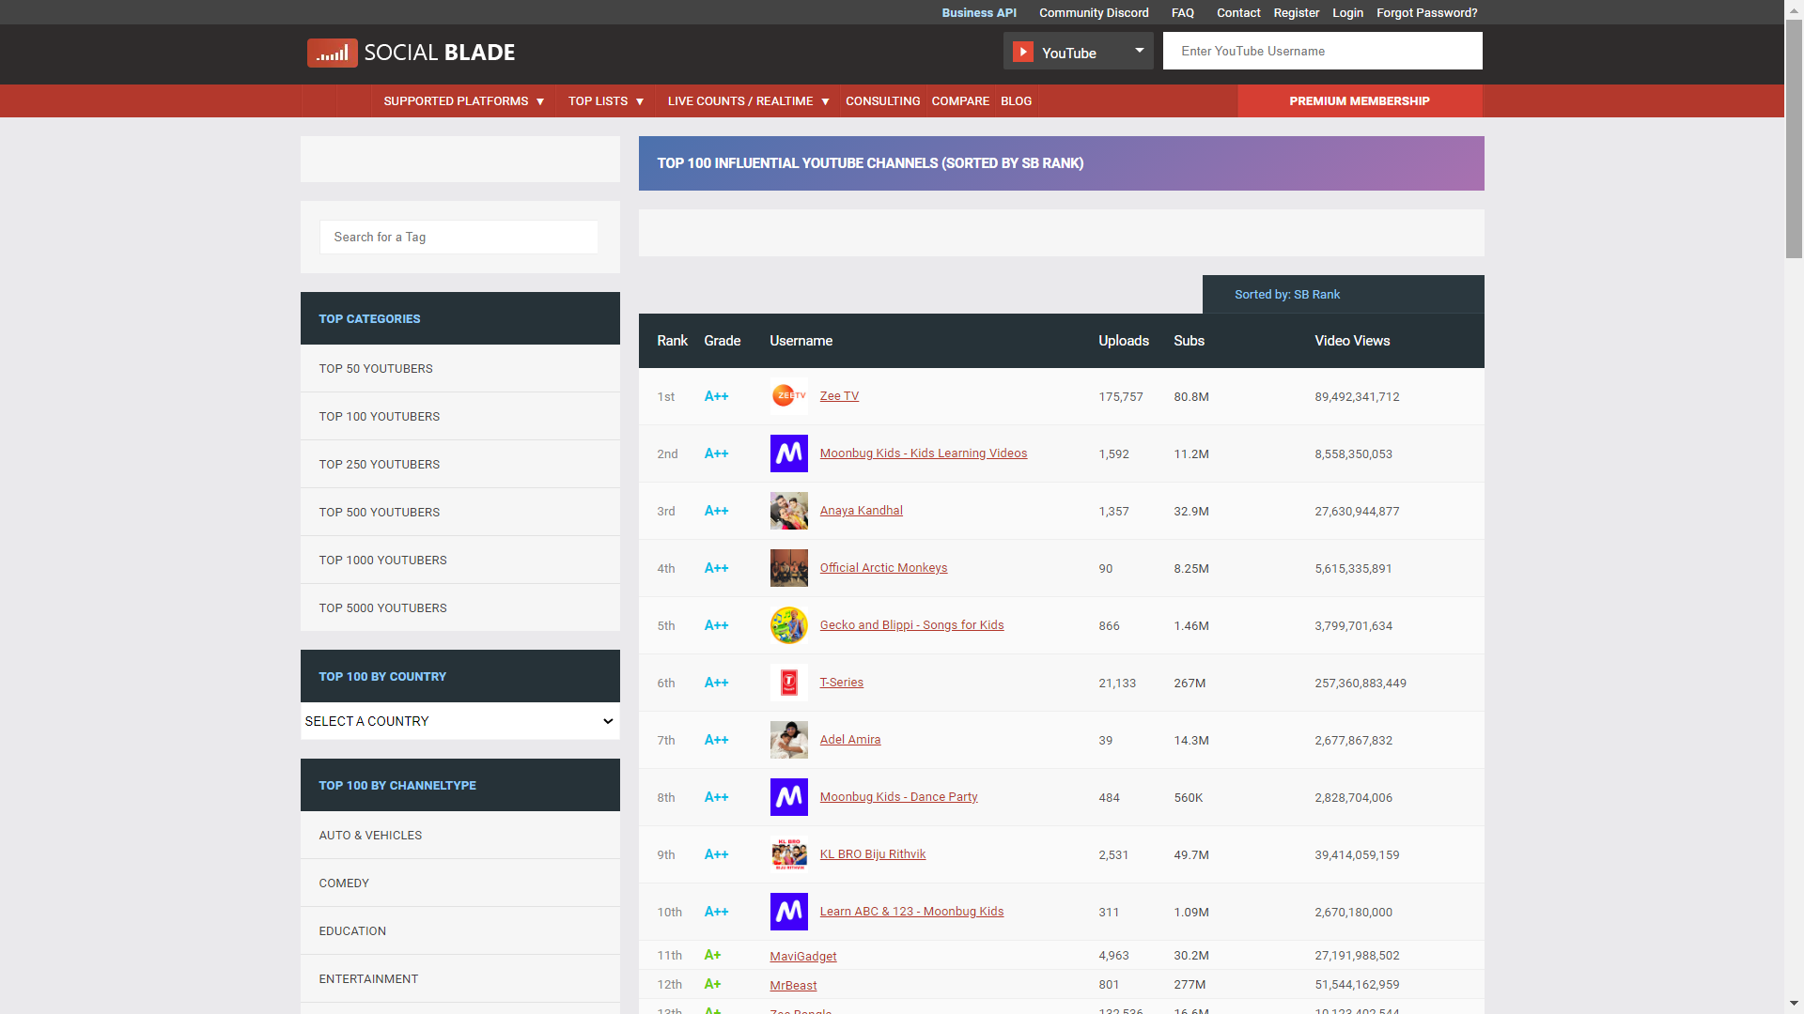
#2: Scrape
Social Blade
Top Channels

Slide 9
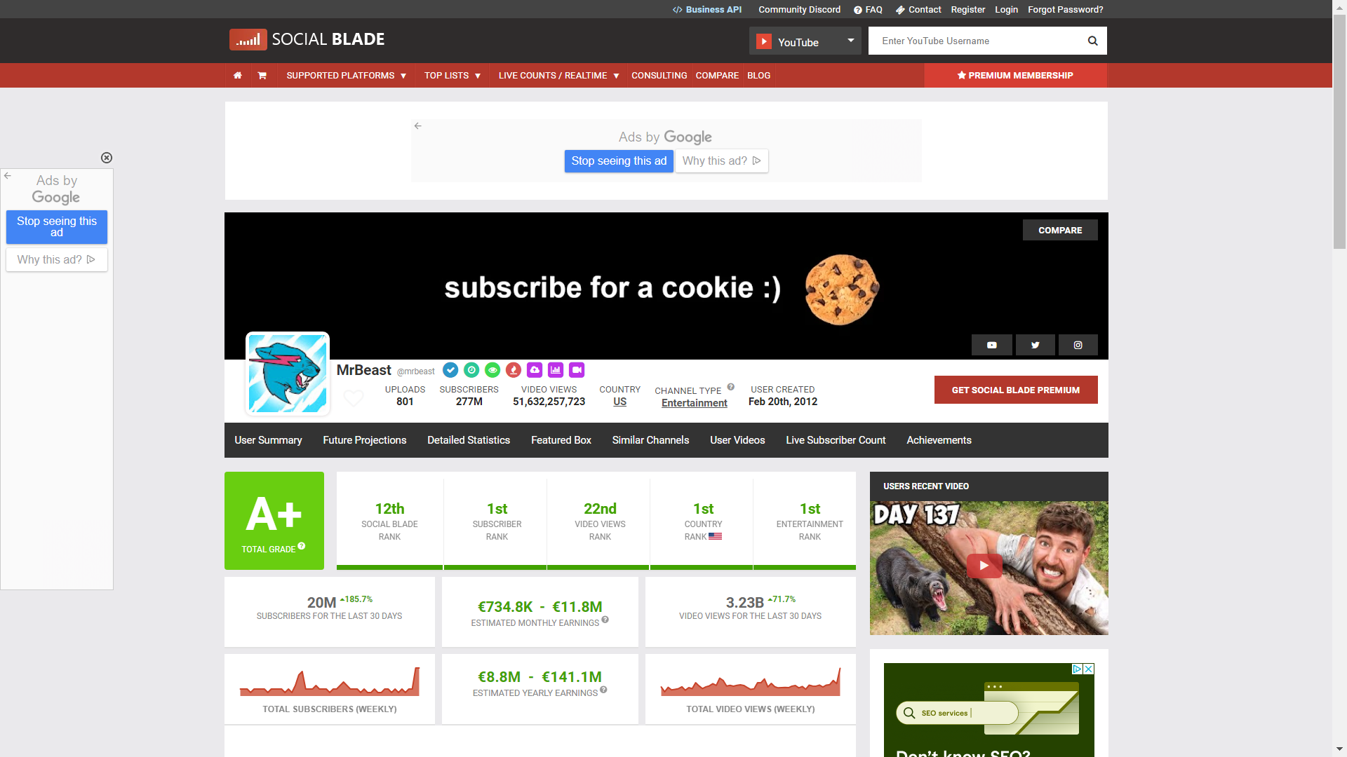
#2: Scrape
Social Blade
Top Channels
Channel Info

Slide 10
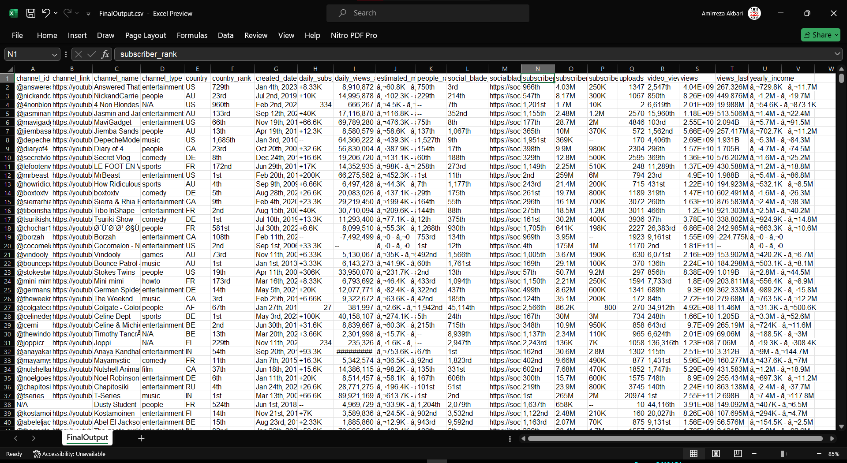
#2: Scrape
Social Blade
Top Channels
Channel Info
Raw Data

Slide 11
#2: Scrape
channel_id
@answeredthatforyou, @nickandcarrie, …
channel_link
https://youtube.com/@mrbeast, …
channel_name
Cinema Home, Super Max, Once Minutos, …
channel_type
tech, sports, news, music, games, …
country
US, RU, IT, FR, IN, AF, …
country_rank
52nd, 41st, 256th, …
created_date
Feb 7th, 2006 - Sep 17th, 2019 - …
daily_subs_average
200, 334, +17.3K, +1.66K, …
daily_views_average
299728, 33488, 23356642, …
estimated_monthly_income
â‚¬68 - â‚¬1.1K | â‚¬97.4K - â‚¬1.6M | …
people_rank
2,753rd, 841st, 1st, …
social_blade_rank
508,110th, 418th, 63rd, …
socialblade_url
https://socialblade.com/youtube/channel/UCFbcWuTxU0MiS GZpVHxPeJg
subscriber_rank
1,001st, 150th, 13,883rd, …
subscribers
3.48K, 7.95M, 289, …
subscribers_last_30_days
6.54K, 800, 20.3K, …
uploads
28272, 385, 1599, …
video_view_rank
615,473rd, 1,302nd, 128th, …
views
50895743, 784043224, 12628, …
views_last_30_days
1.071B, 552.227M, 457.267K, …
yearly_income
â‚¬24.5K - â‚¬392.8K | â‚¬1.8K - â‚¬28.6K | …
Social Blade
Top Channels
Channel Info
Raw Data
Sample Data

Slide 12
Phase #1
Phase #2
Phase #3
Dataset
Scrape
EDA
Youtube Channels
Purpose
Target Variable
Scrapy Framework
Social Blade
Top 100 channels in 24 countries
Preprocessing
Plots
Analyses

Slide 13
#3: EDA
Preprocessing:
Handle Missing Values
Handle Data with Errors
Clean Income Data & Convert to Numerical Values
â‚¬60.8K - â‚¬973.1K ➔ 516950
Convert Shortened Numeric Values to Simple Form
8,910,872 ➔ 8910872 267.326M ➔ 267326000
Detect Outliers

Slide 14

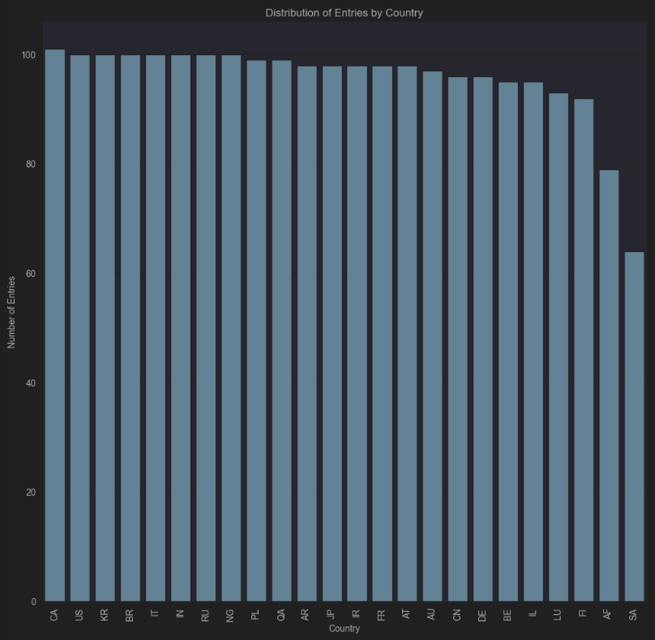

Distribution of Countries
We scraped the same number of channels from each country but some data were lost while scraping or dropped due to errors in preprocessing

Slide 15
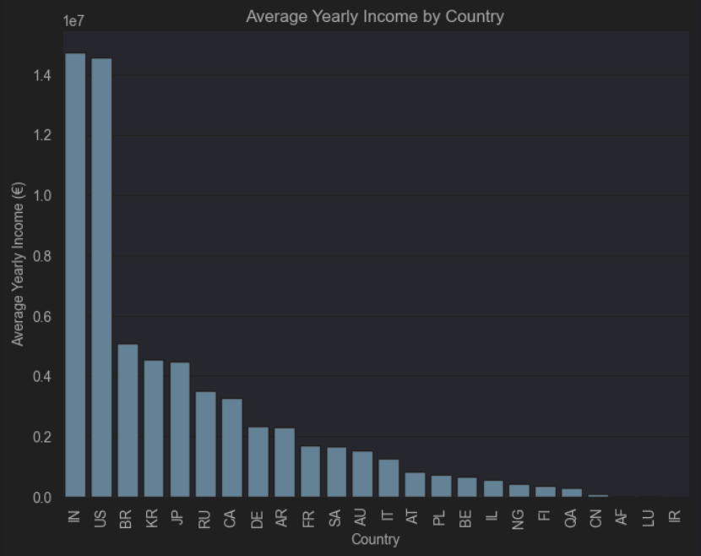
Average Yearly Income
Lowest:
Iran
Luxembourg
Afghanistan
Highest:
India
USA
Brazil

Slide 16
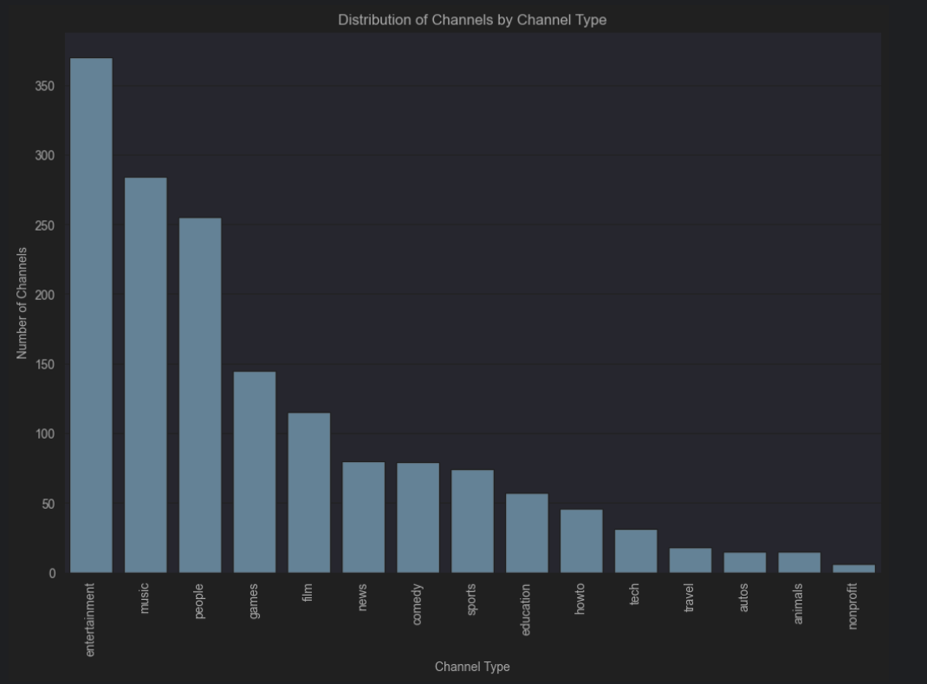
Distribution of Channel Types
Lowest:
nonprofit
animals
autos
Highest:
entertainment
music
people

Slide 17
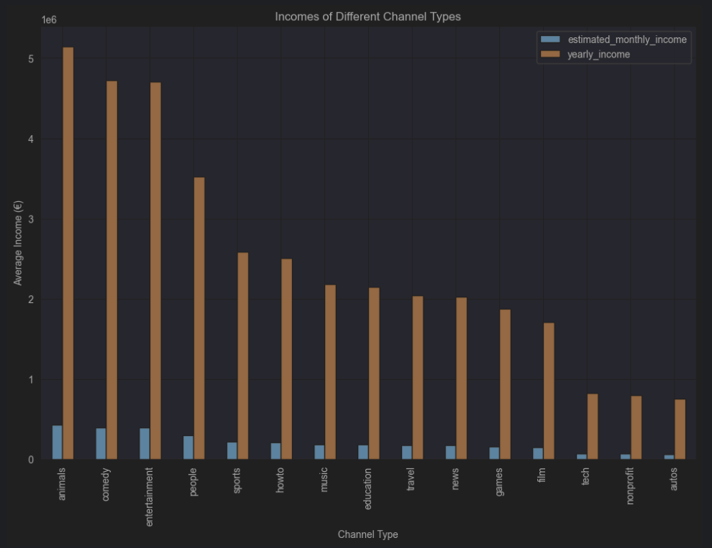
Income of Channel Types
Lowest:
autos
nonprofit
tech
Highest:
animals
comedy
entertainment

Slide 18
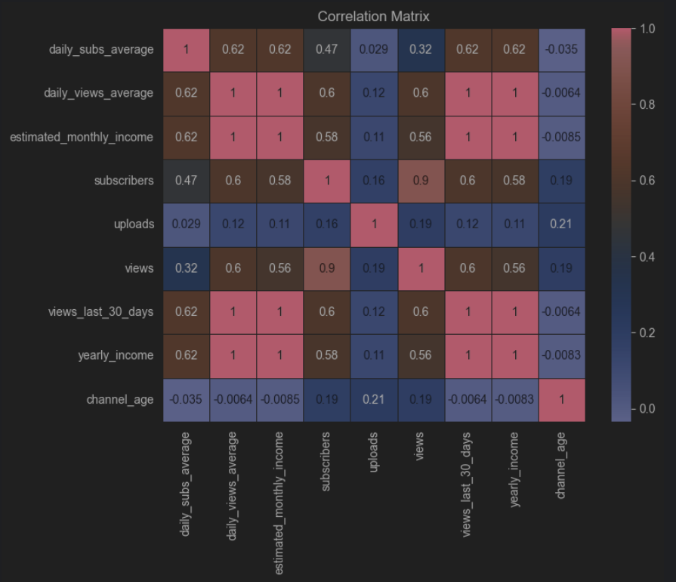
Correlation Matrix
Mostly Correlated Features with Yearly Income:
Daily Subscribers
Total Subscribers
Total Views
Least Correlated Features with Yearly Income:
Uploads
Channel Age

Slide 19
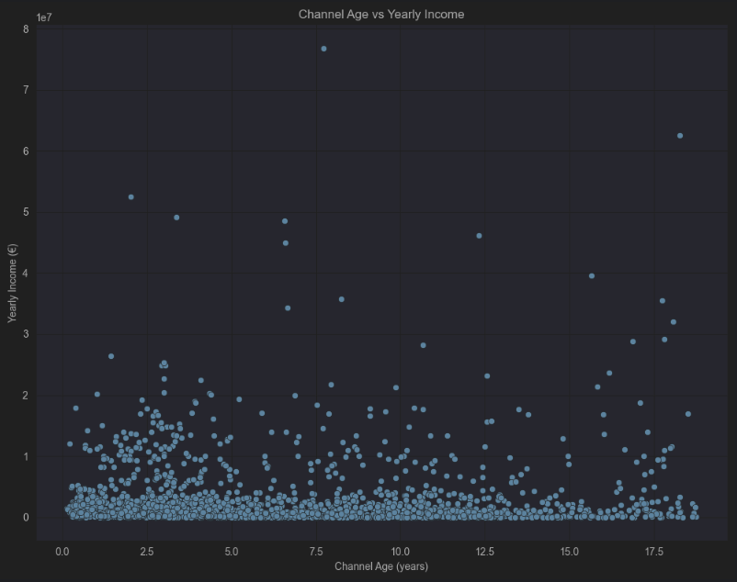
Channel Age
vs
Income
No Significant Correlation

Slide 20
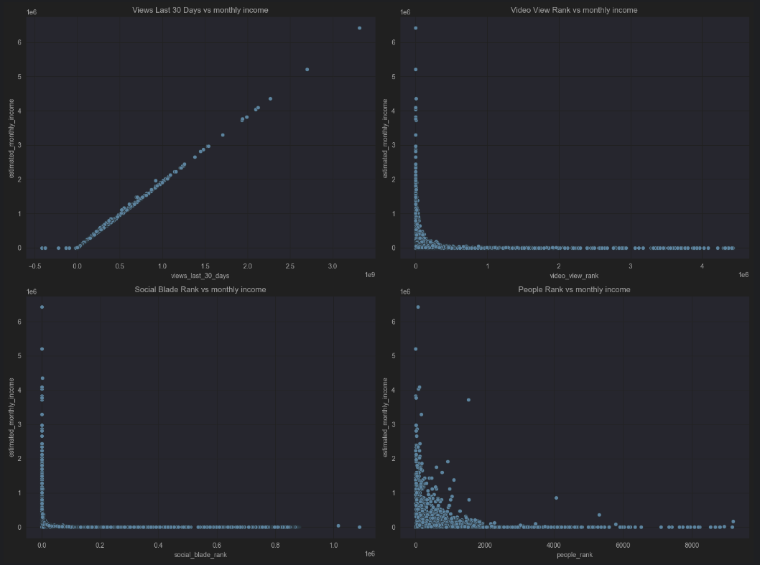
Ranks
vs
Income
No Significant Correlation

Slide 21




a glimpse of FUTURE
2
1
3
Predict
Train
Evaluate

Slide 22

Thank You

